Slide 1
Boeing NLP4RE Task – Documentation May 2022
Prepared by:
Dr. Olivia Pinon Fischer: Olivia.pinon@asdl.gatech.edu
Cengiz Akinli: cengiz.akinli@aerospace.gatech.edu
Miyako Wilson: miyako.wilson@gatech.edu
Archana Tikayat Ray: atr@gatech.edu

Slide 2
Introduction

Slide 3


Approach
Raw requirement
Requirement Classification
Patterns
Step #1
ENVIRONMENTAL
SUITABILITY
DESIGN
…..
Term-Definition
Matrix
Boilerplates Elements Identification
Step #2
Ranking of Suggested Requirements
Step #3
Phase 2?
User selected requirement

Slide 4
Code Accuracy – Per requirement type and per element
 | Environment Requirements | Suitability Requirements | Design Requirements
Agent | 97% | 88.5% | 94.74%
Condition/Event | 84% |  | -
Characteristic | - | 47.4%
Section and Resource | 96% |  | 100%
Boundary and Value | 61% |  | 94.74%
When (during, after, during after) | 100% |  | -

Slide 5
Definitions
spaCy Version used: 3.2 (Link)
Model: English Transformer pipeline (roberta-base)
Doc: A container for accessing linguistic annotations (Link)
Tokenization: separating text into smaller units (tokens) – word, character, sub-words
Noun chunks: base noun phrases that have a noun as their head
Parts-of-speech (POS): Eight main parts of speech – nouns, pronouns, adjectives, verbs, adverbs, prepositions, conjunctions, and interjections
The car can carry 5 people.
The
car
can
carry
5
people
tokenization
Autonomous cars shift insurance liability toward manufacturers.
Root text
Root text
Root text
The car can carry 5 people.
DET
NOUN
AUX
VERB
NUM
NOUN

Slide 6
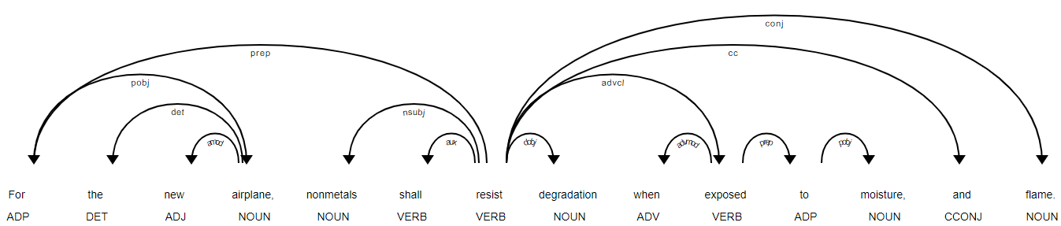
Definitions
Dependency Parsing (DEP): analyzing grammatical structure of a sentence, establishing relationships between the “head” words and the words which modify those heads
Named-Entity Recognition (NER): involves recognizing named entities such as people, places, organizations, currencies, etc.
Phrase Matcher: match sequences based on lists of token descriptions (Link)
PhraseMatcher accepts match patterns in the form or Doc objects
Georgia Tech is in Atlanta, GA.
Georgia Tech
ORG
Atlanta, GA
LOC

Slide 7
Boiler Plate Identification

Slide 8
Handlers
There is one abstract handler class (RequirementHandler) and three handler classes:
EnvironmentHandler, SuitabilityHandler, and DesignHandler for each type of requirement
Function of each handler:
Read “Term Definition” excel file.
Read “Patterns” excel file.
Read a string sentence
Perform pre-processing:
Remove white space(s) from front and end of a sentence
Remove “.” from the end of line if exists
Replace multiple space to one space
Create spaCy’s doc object by parsing the modified sentence
Each handler has a process method that defines which parser to use for the requirement
The order of parser in the process method does not change the identification outcome

Slide 9
Parser
Parser creates Element from spacy's tokens.
ElementParser – abstract class for all Parser.
There two types of parser
ElemengGroup Parser
ArticleAgentParser - create ArticleAgent element that contains Article and Agent elements
BoundaryValueParser – create BoundaryValue that contains Boundary and Value elements
SectionResourceParser – create SectionResource that contains Section and Resource elements
SingleElementParser
ConditionEventParser – create Condition element. Developed for Environment requirements. Modification is likely to require for Design.
WhenParser – create When element to extract "after", "during", or "during and after" element
StateParser – create State element
CharacteristicParser – create Characteristic element

Slide 10
Data Class Structure
Element – abstract super class of all elements identified. This contains method used by the editor to display text and its Confidence value.
Methods:
List(String): getTexts() - string representation of the element. It is a list because one element with multiple texts (ie., Any Crew Oxygen Hose, Each Crew Oxygen Hose).
Float: getConfidenceValue() - Float value representing confidence of this element identified. Larger the value, more confident it has.
Span: getTokens() - Span used in identified elements. For example, "not", "be", "affected ", "by" are not used to identify elements for "The Crew Oxygen hoses shall not be adversely affected by weathering.", so they are not included in getTokens().
SingleOrGroupElement - an abstract super class for SingleElement and ElementGroup.
Methods: Boolean getFit() - True if this element is not likely required input from a user.
SingleElement – subclass of SingleOrGroupElement
Elements combined in ElementGroup are Article, Agent, Section, Resource, Boundary, and Value
Non-grouped elements identified individually are Condition, State, When, and Characteristic
ElementGroup – subclass of SingleOrGroupElement and super class of ArticleAgent, SectionResource, and BoundaryValue.
ConjElements – subclass of Element and super class for AgentConj, SectionResourceConj, and BoundaryValueConj. To support multiple same typed elements in a sentence connected by conj (“and”)
For example, a sentence is “A and B should satisfy… “, then AgentConj (conj = “and” token, elements = Agent(“A”) and Agent(“B”)) will be created.
Properties: expand : Boolean – if True, two sentences should be created. For the above example, the two sentences will be “A should satisfy…” and “B should satisfy…”
Methods: List(TokenSpan): getConj(), List(Element): getElements(), Boolean getExpand()

Slide 11
Confidence
Confidence enumeration symbol is assigned to each SingleElement.
An element can have more than one Confidences.
Most of Confidences are for specific elements.
The Confidence value of each SingleElement is assigned in its setConfidenceValue method.
For example, State element can be identified Term and/or Pattern_DEP_after. Their values are assigned as 1.0 and 0.9 arbitrary. If the State is identified with just Term confidence, the element's confidence value is 1.0. If the State is identified as just Pattern_DEP_after, the element's confidence value is 0.9. If the State is identified with both confidences Term and Pattern_DEP_after, the element's confidence value is 1.9.
The Confidence of GroupedElement (ie., SectionResource) is sum of Section and Resource confidence values.
Match # Confidence for elements which has a known text(s). - "after", "during", "during and after" for When element, "The", "Each", "Any" for Article element.
Term # Confidence for an element when the element's a part or whole text is in the Term Definition excel file.
StartsWith # Confidence of an element whose text starts with the "Start With" column words in the Patterns excel file.
Pattern_of # Confidence of grouped elements (Section and Resource of SectionResource), when they are connected by "of" (ie., Section A of B).
Pattern_resource_section # Confidence of grouped element(Section and Resrouce of SectionResource), when they has a pattern of RESOURCE followed by SECTION (i.e, DR&O Section 2.12)
Pattern_DEP_after # Confidence of Condition/Event following a word in "After" column words of the Pattens excel file (i.e., exposed to salt spray)
DEP_NsubjNsubjpass_ROOT # Confidence of Agent whose noun-chunk root is pointed from DEP:ROOT token as DEP:nsubj or DEP:nsubjpass.
DEP_NsubjNsubjpass # Confidence of Agent whose noun-chunk root is DEP:nsubj or DEP:nsubjpass.
Similar # Confidence of Agent whose noun-chunk text is similar to already identified Agent (ie., "The fuel tank" from already identified "The tank")
Term_Unit # Confidence of Boundary and Value elements when the element is identified from the "Unit" of the Term Definitions.xlsx.
DET_This # Confidence of Section and Resource added when the word is already identified but having "this" in front of it.
Agent_of # Confidence of Agent when the Agent is found from other identified agents (can be invalid ones too) connected by "of" (ie., "The Engine Bleed Air Temperature" from "The probability of engine bleed air temperature")

Slide 12
Logic for ArticleAgent
12
ArticleAgentParser creates ArticleAgent which identifies both Article and Agent
Article:
After an Agent is identified, the word before the agent is evaluated to create Article
“All” is changed to “Any” and “Each”.
A plural agent , “The” is changed to “Any/Each”.
A singular agent, “The”, “Each”, and “Any” remains as is.
Only has one type of confidence: Match and its value is assigned as 1.0.

Slide 13
Logic for Agent
13
If an agent is plural, the agent is converted into singular.
An agent text is converted to Title Case (ie., “The fuel tank” to “The Fuel Tank”)
There are five types of confidences in Agent. It is possible to assign more than one confidence type in an agent. The value is assigned from 0 to 1 arbitrary
Confidence.Term = 1.0
Confidence.DEP_NsubjNsubjpass_ROOT = 0.9
Confidence.DEP_NsubjNsubjpass = 0.5
Confidence.Similar = 0.4
Confidence.Agent_of = 0.6
The OBJECT tab of Term Definition.xlsx is used for Agent.
Invalid agent words (not to be identified as agents) are defined in the Term Defintion.xlsx: prefix with “-” (i.e., “-probability).
Unfit agent words (identified as agents but requires user modification) are defined also in the Term Defintion.xlsx: prefix with “*” (i.e., “*sensor).

Slide 14
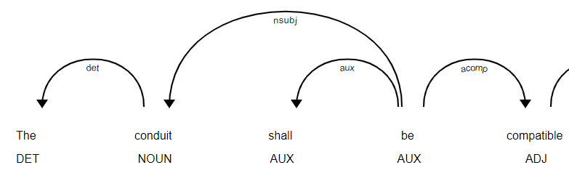
Logic for Agent
Step 1: Find agents with Term Confidence.
If a word in a sentence is in the OBJECT tab of Term definition, the word is identified as an agent. If noun chunks in a sentence included the word, then the noun-chunk word(s) is also identified as an agent.
For example) “ASCS” is in the Term definition, and a sentences is “The ASCS equipment shall meet …”, then “The ASCS” and a noun chunk “The ASCS equipment” are identified as Agents.
Step 2: Find agents with DEP_NsubNsubjpass_ROOT confidence.
If a noun-chunk word a connected from DEP:Root and DEP:nsubj or DEP:subjpass, then the word is identified as an agent.
For example) A sentences is “The conduit shall be compatible …” and “The conduit” is nsubj from Root (“be”) and is a noun-chunk, then “The conduit” is identified as an Agent.

Slide 15
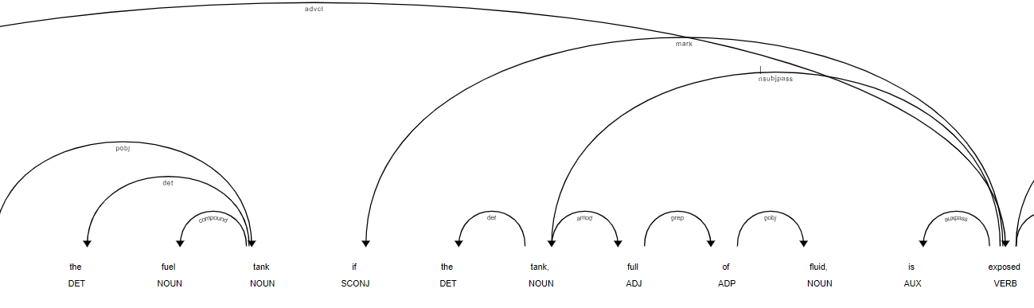
Logic for Agent
Step 3: If no agents are found with Term or DEP_NsubNsubjpass_ROOT confidences, find an agent with DEP_NsubNsubjpass confidence.
If a noun-chunk word and DEP:nsubj or DEP:subjpass, the word is identified as an agent. Only no agents are found. .
For example) A sentences is “There shall be no permanent damage to the fuel tank if the tank, full of fluid, is exposed to…”, “The Tank” is identified as an agent because it is a noun-chunk and DEP:nsubjpass. The DEP:Root is “be”.
Step 4: If no agents are found with Term or DEP_NsubNsubjpass_ROOT confidences and identified an agent with DEP_NsubNsubjpass, then identifies an agent with Similar confidence.
If a noun-chunk word is similar word to the DEP_NsubNsubjpass agent, the word is identified as an agent.
For example) A sentences is “There shall be no permanent damage to the fuel tank if the tank, full of fluid, is exposed to…”, “The Tank” is identified as an agent with DEP_NsubNsubjpass confidence. Then the noun-chunk strings similar to the agent “The fuel Tank”, is identified as an agent.

Slide 16
Logic for Agent
Step 5: Use all agents identified (including invalid agents) to find an agent with Agent_of confidence.
If a noun-chunk word is following “of” after agents, the word is identified as an agent.
For example) A sentence “The probability of loss of airflow termination …” and an invalid agent is “loss”, then “The Airflow Termination” is identified as an agent.

Slide 17
Logic for Condition/Event
ConditionEventParser creates Condition/Event elements.
This logic is mainly developed for Environment requirement.
The Condition/Event text is converted to Title Case (ie., “salt spray” to “Salt Spray”)
There are two types of confidences in Condition/Event. It is possible to assign more than one confidence type in a Condition/Event. The value is assigned from 0 to 1 arbitrary (definitions in next slide)
Confidence.Term = 1.0
Confidence.Pattern_DEP_after = 0.8
The CONDITION and EVENT tabs of Term Definition.xlsx are used.
The CONDITION tab's After Column is used.
Invalid CONDITION or EVENT words can be defined in the Term Defintion.xlsx: prefix with “-”.

Slide 18
Logic for Condition/Event
Step 1: Find CONDITION/EVENT with Term Confidence.
If a word in a sentence is in the CONDITION or EVENT tab of Term definition.xlsx, the word is identified as CONDITION/EVENT element with Term Confidence.
For AGENT, the noun-chunk contains the Term definition is also identified as AGENT, but for CONDITION/EVENT, the noun-chunk is NOT identified as CONDITION/EVENT for now. Futher evaluation may necessary.
Here is some comparison.
In Term Definition | Noun-chunk
Overpressure | An Overpressure Altitude
QNH altimetry environments | both QFE and QNH altimetry environments
Operated | None
Overpressure | an overpressure equivalent
HIRF environment | HIRF environments
lighting | lightning strike
lightning | a 1,300 volt peak lightning pulse

Slide 19
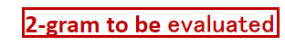
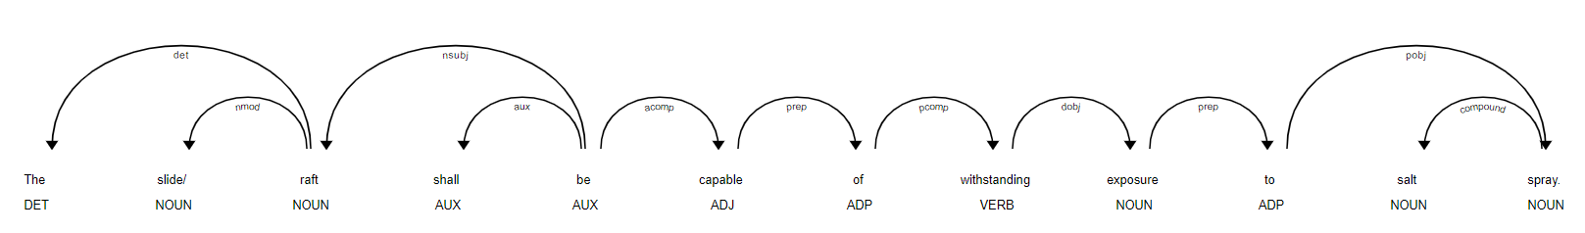

Logic for Condition/Event
Step 2: Find CONDITION/EVENT with Pattern_DEP_after Confidence
Using Patterns.xlsx After column. The list contains phrases likely to follow by Condition/Event.
The slide/raft shall be capable of withstanding exposure to salt spray.
Root.head.head
Root.head
Root
2-1: Find a noun-chunk ("salt spray")
2-2: Find the noun-chunk root("spray")'s head("to") and the head's head("exposure") to 2-gram head text ("exposure to")
2-3: If the text find in the Step2 is in Patterns.xlsx CONDITION tab's After column or not.
2-4: If Step3 is Yes, then consider the noun-chunk("salt spray") as CONDITION.
2-5: Create New ConditionEvent or if the span is already identified in the Step 1, then add Pattern_DEP_after to its Confidence.
**Step2 is different when the noun-chunk root's head is DEP:ROOT, then the text is 1-gram (ie., "withstand")
Patterns.xlsx
After
exposure to
expose to
withstand
operate in
operate within
design support
..

Slide 20
Logic for Section/Resource
SectionResourceParser is used to identify Section and Resource together (SectionResource object).
There are five types of confidences in Section/Resource. It is possible to assign more than one confidence type in an agent. The value is assigned from 0 to 1 arbitrary (Please see Confidence slide for details).
Confidence.Term: 1.0,
Confidence.DET_This: 0.9,
Confidence.Pattern_of: 0.9,
Confidence.Pattern_resource_section: 0.9,
Confidence.StartsWith: 0.8,
The SECTION and RESOURCE tabs of Term Definition.xlsx are used.
The SECTION and RESOURCE tab's Starts With Column of Patterns.xlsx are used.

Slide 21
Logic for SectionResource
Step 1: Find tokens start with Patterns.xlsx Section tab, "Start With" column words
Step 2: Find tokens start with Patterns.xlsx Resource tab, "Start With" column words
Step 3: Find tokens match with Term Definition.xlsx Section tab
Step 4: Find tokens match with Term Definition.xlsx Resource tab
Step 5: Combine step1 and step3 tokens for Section and step2 and step4 tokens for Resource.
Step 6: Create Section and Resource elements with the tokens from step5 and add appropriate confidence(s) (Confidence.Term and/or Confidence.StartsWith)
Step 7: Create SectionResource element if Section and Resource are related with one of the following patterns. Add appropriate confidence to related Section and Resource.
Resource Section (ie., DR&O Section 2.12) - Confidence.Pattern_resource_section
Section of Resource (i.e., Section 3.1 of This SCD) - Confidence.Pattern_of
Precede with "This" (i.e., This SCD) - Confidence. DET_This
Step 8: Convert to SectionResourceConj element if a sentence containing two SectionResource objects connected with "and".

Slide 22
Logic for Characteristic
CharacteristicParser identifies characteristic phrases for the templates that expect one.
Step 1: Find all noun chunks.
Step 2: Select terms in the found phrases that are listed in the given term definitions. (confidence=0.9)
Step 3: Evaluate remaining noun chunks and exclude the agent (dependency target of type "nsubj" or "nsubjpass").
Step 4: Evaluate remaining phrases and immediately accept those that are dependency target(s) of type "dobj".
Step 5: Evaluate remaining and accept those that match given characteristic patterns (confidence=0.8)

Slide 23
Logic for BoundaryValue
Finding Boundary & Value from a requirement statement
Gazetteer
(Rules-based Method)
Machine Learning
Uses a dictionary
Based on NLP – NER
(More details above the above can be found on the NER slides) – Slide 32-42
Gazetteer (Rules-based Method) was used for the identification of BoundaryValue
NER was not used, because:
Some of the Values were not being identified due to the following non-uniformities:
-3.1 to 3.1 GHz → “GHz” missing after the first value
31 F vs. 31°F → different ways of representing “degree Fahrenheit”
Use of units that are specific to aerospace-domain: per flight hour, operating hours, etc.

Slide 24
Logic for BoundaryValue
Each dedicated Direct Mode yaw 1.3 Hz rate sensor shall operate properly in between 1.3 Hz & 3.1 Hz.
Step 1: Default Boundary is set to “equal to”
Step 2: Loop iterates over and looks for matches in the excel file for Value (Unit) in the _doc and retrieves the start and end indices
Step 3:
If “°” (degree) occurs in the Unit → Value object is appended with (start_index-2) till (end_index) → e.g., 30°C
Boundary is assumed to be (start_index-3)
If “°” (degree) DOES NOT occur in the Unit → Value object is appended with (start_index-1) till (end_index) → e.g., 1.3 Hz
Boundary is assumed to be (start_index-2)
From VALUE sheet of Term Definitions.xlsx
Each dedicated Direct Mode yaw 1.3 Hz rate sensor shall operate properly in between 1.3 Hz & 3.1 Hz.
Value
Boundary

Slide 25
Logic for BoundaryValue
Step 4 (identification of Boundary): Check if Boundary is in the excel sheet
If Boundary is “between” or “from”, replace with “greater than”
If previous Boundary was “between” or “from”, then the next Boundary is auto-assigned to “less than”
In Steps 3 and 4, we create individual lists for Boundary and Value
Step 5 (combining Boundary and Value): Each element in Boundary list corresponds to element in the Value list by matching indices
If the Boundary contains “and”, then it is considered a conjunction
Conjoint object is created → e.g., greater than -1.3 Hz and less than 3.1 Hz
If the Boundary DOES NOT contain “and”, then there is no conjunction
Boundary
at least
at most
equal to
not equal to
greater than
less than
interior of
exterior of
compatible with
not compatible with
only
every
during and after
during
after
up to
between
range of
From BOUNDARY sheet of Term Definitions.xlsx
equal to
greater than
1.3 Hz
Each dedicated Direct Mode yaw 1.3 Hz rate sensor shall operate properly in between 1.3 Hz & 3.1 Hz.
Value
1.3 Hz
and less than
3.1 Hz
Boundary
New Boundary + Value

Slide 26
Named-Entity Recognition (NER)

Slide 27
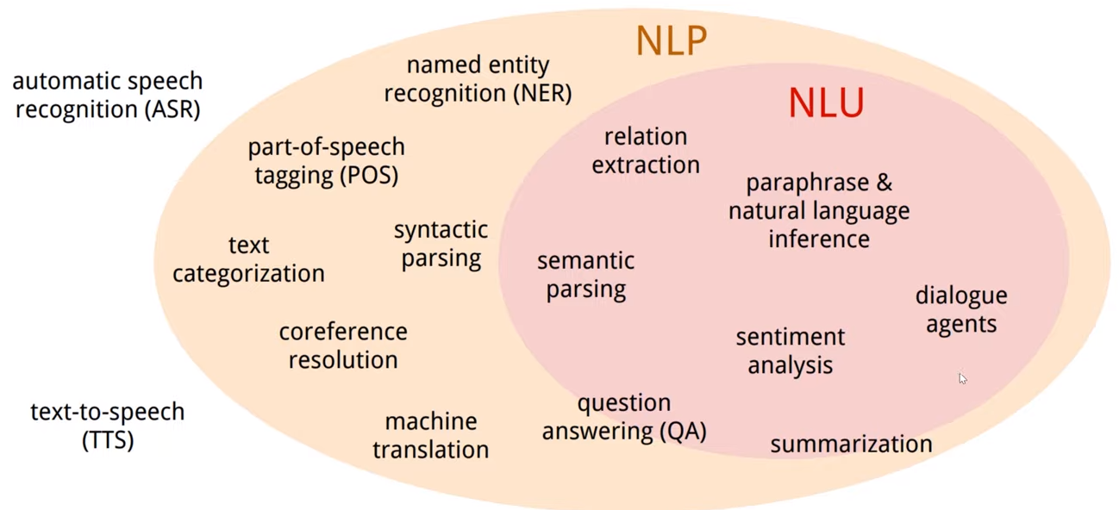
NLP and NER
Natural Language Processing (NLP): branch of artificial intelligence (AI) which gives computers the ability to understand text and spoken words
Named-Entity Recognition (NER): involves recognizing named entities such as people, places, organizations, currencies, etc.
How can Named-Entities be helpful?
Extracted named-entities can be used to produce a glossary (Resources used, Abbreviations, etc.)
Helpful for stakeholders to look up technical terms in system’s domain
Improve accuracy and understandability of requirements
Apple
ORG
Tim Cook
PER
Apple’s CEO is Tim Cook
Computer Science
Linguistics
NLP

Slide 28
Identifying Named-Entities (NE)
NER
Gazetteer
(Rules-based Method)
Machine Learning
Uses a dictionary
Uses NLP
Pros:
Easy to create a lookup table for small projects
Cons:
Linguistic ambiguities such as typos (in NEs) will lead to them not being identified
Does not generalize
Tedious to define rules for everything
Does not scale – storage of the rules, lookup tables, etc.
Pros:
Generalizes – don’t have to define numerous rules (or case statements)
Once trained, the model can be used for identifying NEs
Scales well for large projects
Cons:
Annotation can be tedious one-time task

Slide 29
Language models (LMs)
Flowchart showing training of LMs and using them for predictions
Language modeling is the task of predicting what word comes next ^{[52]}
Language Model
Annotated corpus
Statistical language model
Neural language model
Model Training
(for NER)
Probability distribution over sequence of words
Uses continuous representations (embeddings) of words to make their predictions
Test set
Tagged NEs
Example:
N-gram
Exponential
Bidirectional
Continuous space
Example:
Fixed-window
Recurrent Neural Networks (RNNs)
LSTM
GRU
RNN variants
BERT, GTP-2, etc.
Glossary
Req. Boilerplate

Slide 30
Language models – Domain Adaptation
LM
Pre-trained
Train from scratch with in-domain text
Training Data: General domain text (Wikipedia, news articles, Book Corpus, etc.)
Pros:
Available off-the shelf
Works well on a lot of tasks with state-of-the-art results
Cons:
Might not generalize well to aerospace-specific text
Training Data: In-domain text(aerospace)
Pros:
Performs well on in-domain texts which are not well represented in general domain text
Cons:
Might require significant amount of training data depending on the model of choice
1
Fine-tune
2
Notes:
As mentioned before, a text corpus is required to train language models. Often, Language models are trained on general-domain corpora (such as Wikipedia, web content, etc.), which leads to bad performance when these models are used in scientific/engineering domains such as aerospace.
Generalize → Perform well on data it has not seen before

Slide 31
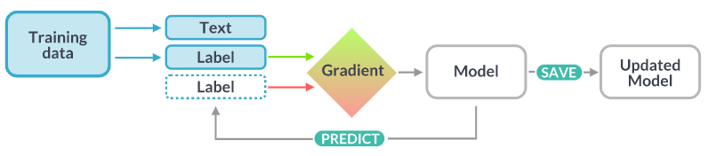
NER identification for requirements
NERs of interest:
Resource
Boundary
Value
Source: spaCy
Definitions:
Training Data: Example text and their annotations
Text: The input text the model should predict a label for
Label: The label the model should predict
Gradient: The direction and rate of change for a numeric value. Minimizing the gradient of the weights should result in predictions that are closer to the reference labels on the training data.

Slide 32
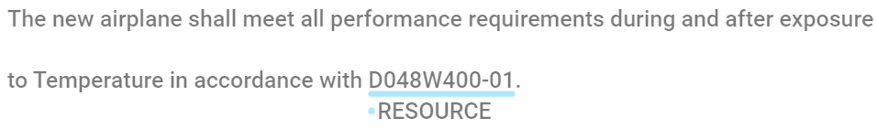
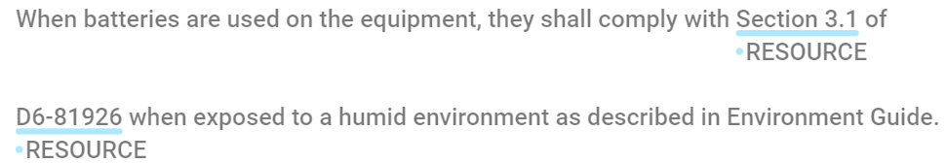
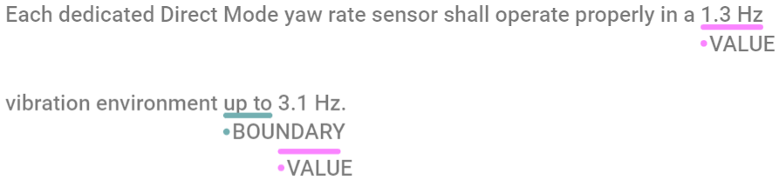
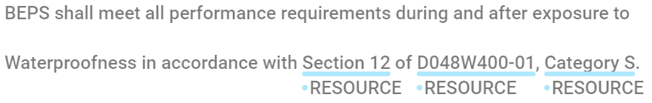
NER identification – Text Annotation
Very important to have fixed and well-defined annotation criteria
Section 3.1 of D6-81926
1
Section 3.1 of D6-81926
1
2

Slide 33
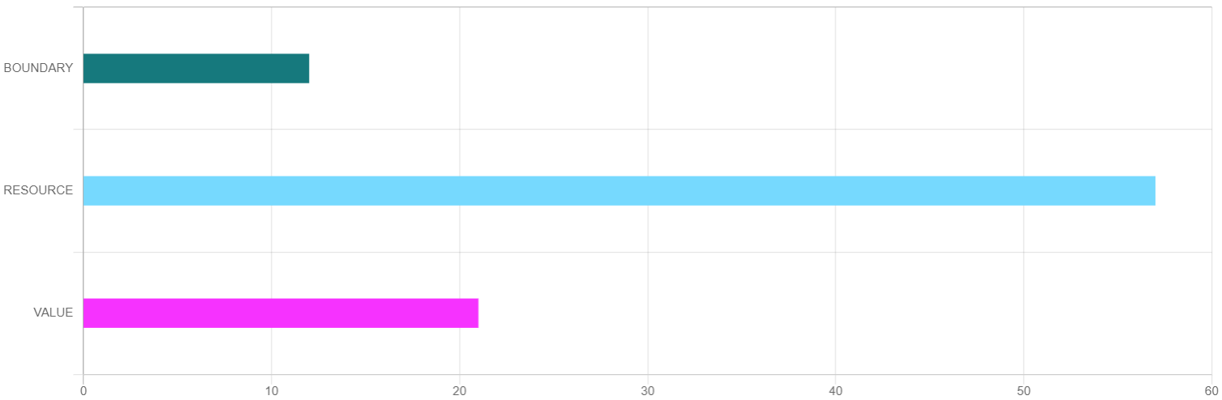
NER identification – Text Annotation
131 environmental requirements were as the training set (very small!!)
spaCy model was trained on environmental requirements
Examples from Design requirements were used as test set
12
57
21
Distribution of annotated entities in environmental requirements

Slide 34
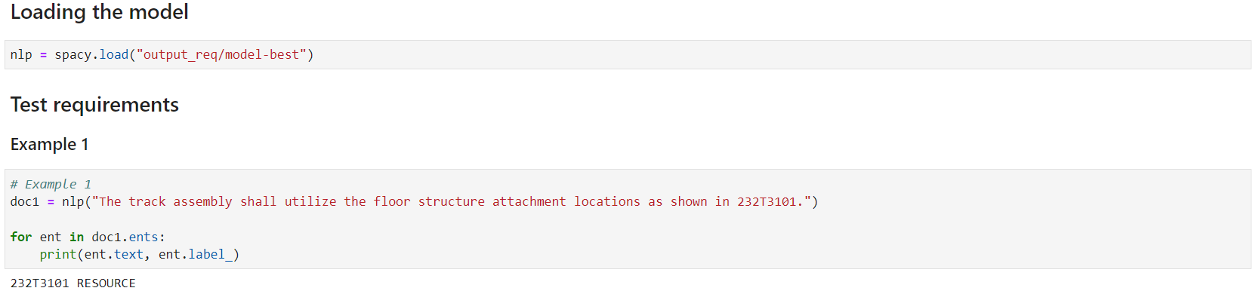
Results
Initial Observations:
Resources of the form “Section 3.3.1.3” are not being identified
“78783-0147” and similar were identified
None of the Boundary/Values were identified
Limited occurrence of Boundary/Value in training set

Slide 35
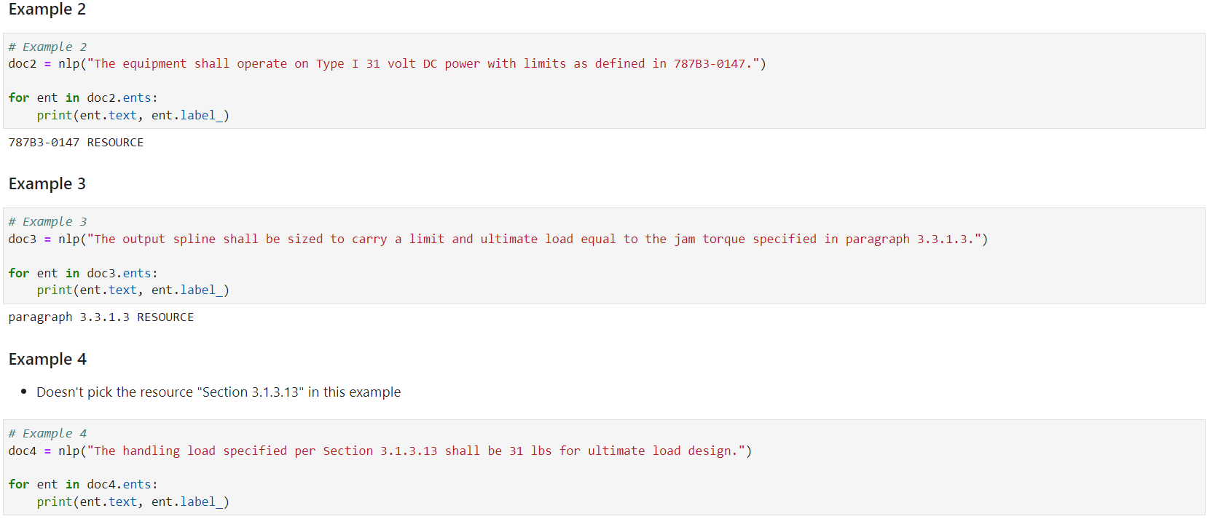
Results

Slide 36
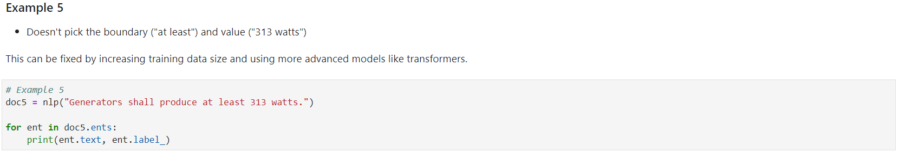
Results

Slide 37
User Interface

Slide 38
User Interface
Requirements are processed sequentially through a web-based interface (Flask).
Upon selection, each is evaluated by a pre-trained classification model (trained on a portion of the given requirements).
=================================================================
Total params: 246,203
Trainable params: 246,203
Non-trainable params: 0
_________________________________________________________________
model tested
Misprediction 1: req 7, predClass 2, actualClass: 0
Misprediction 2: req 14, predClass 0, actualClass: 1
Misprediction 3: req 25, predClass 2, actualClass: 1
Misprediction 4: req 30, predClass 0, actualClass: 1
Model accuracy: 0.9024390243902439% (Correct: 37 of 41, wrong: 4)
* Serving Flask app 'ui' (lazy loading)
* Environment: development
* Debug mode: on
* Running on http://127.0.0.1:5000/ (Press CTRL+C to quit)
Classification model achieved 90.2% accuracy in test set.

Slide 39

User Interface
Requirement selection
Requirements are handled sequentially without context (classification does not assume any similarities between current and previous selections).
Input order is suggested by the drop-down ordering, but not enforced—user may select out of order, if desired.

Slide 40
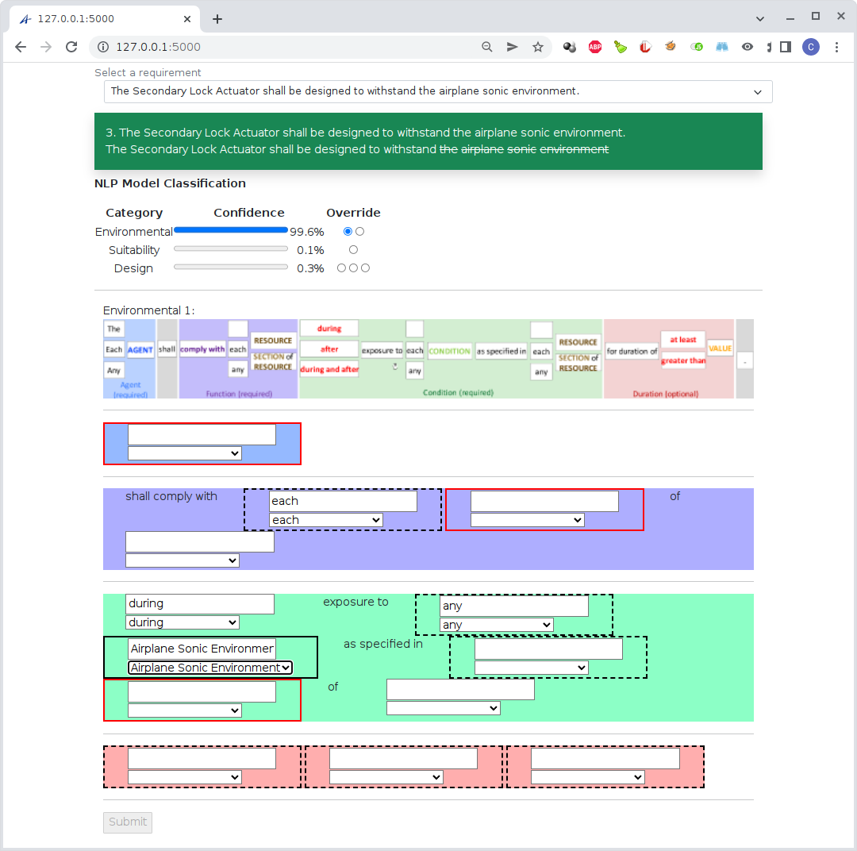
User Interface
Template Classification and Display
Upon selection, classification model determines requirement type and preselects the corresponding template.
If a type has multiple templates, the first is always selected.
User can override type and/or template selection.
User selects phrases for each boilerplate element from drop-downs or typing directly.
Red-boxed elements are required.

Slide 41
User Interface
Template Classification and Selection
Type/template override triggers immediate loading of the corresponding template.

Slide 42
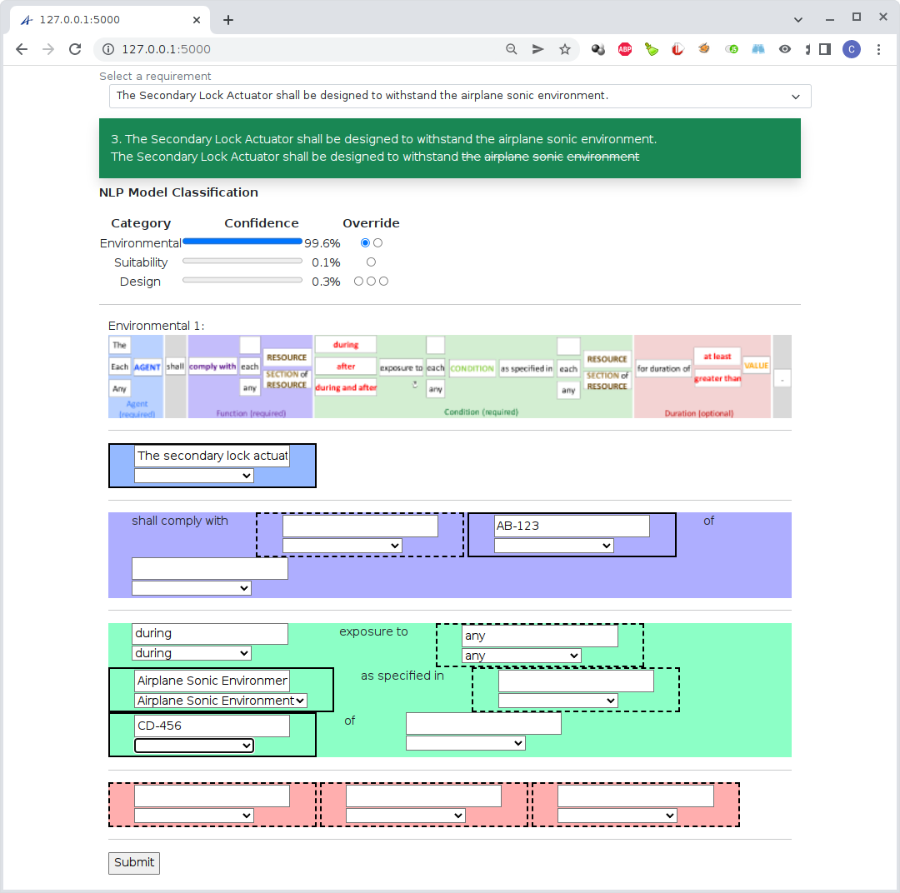
User Interface
Template Classification and Selection
Each required box must be filled in with text but may have specifically excluded terms (unfit).
Once every required element is filled in acceptably, the submit button is enabled.
Boilerplate processing is not yet implemented.

Slide 43
Next Steps

Slide 44
Future Improvements
All
Substitute the term definition identified phrases to Name column of the term definition.
Handle default value
Condition/Event
Noun-chunk contains term definition word should be included?
Should include both singular and plural?
How to handle plural (the applied currents ->each/any current)?
Currently Condition/Event is bundled together but may require to separate to be useful for not just environment, but suitability and design.
SectionResource
Conj element support for only two SectionResource element. If more than three, it will just select choices instead of expanding into two sentences.
Improvement: Section ['Shall Function'] 0.8 ['Term'] True is identified with "The HCM shall function under the full range of thermal and moisture environmental conditions that occur during airplane operation."
BoundaryValue
Carry out pre-processing steps to standardize the forms in which values appear
8x10^-3 → 8E-3
Standardization of use of units for easy identification
300lbs vs 300 lbs
30F vs 30 °F
equal to ± 31 VDC

